Slide 1

Master Detail Flow (Prelude to Fragments)
Donny Cordova | Assistant Professor Computer Systems Engineering Technology | Oregon Institute of Technology

Slide 2
Outline
Responsive Design
Tablet Support
High-level Architecture
Adding a Master/Detail Flow

Slide 3

Responsive Design

Slide 4
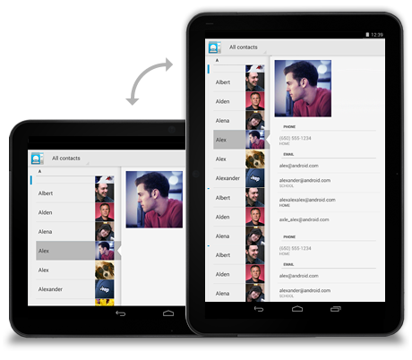
Tablet Support (Honeycomb)

Slide 5
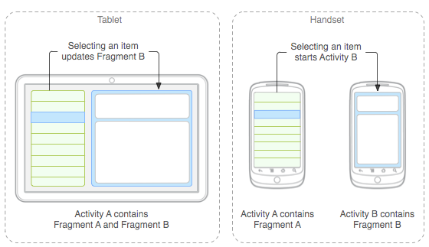
High-level Architecture

Slide 6
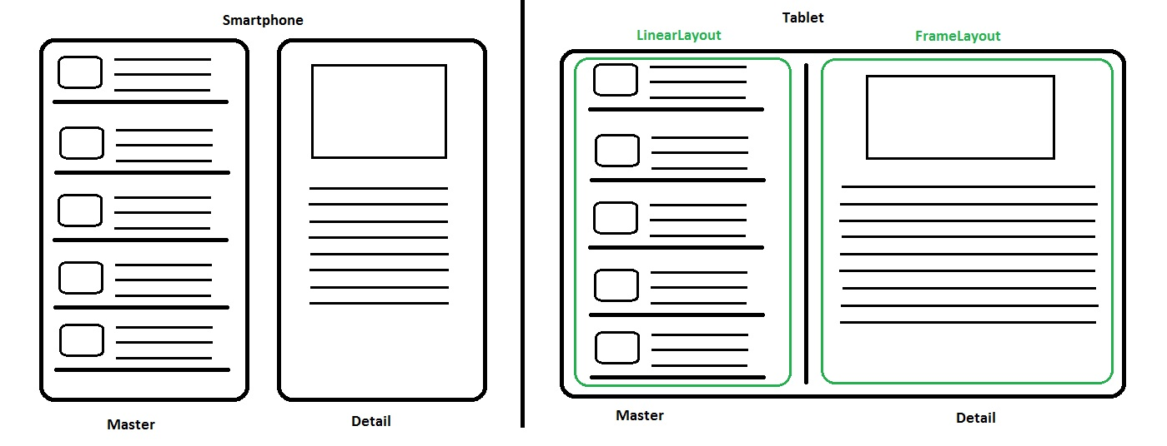
Wireframe

Slide 7
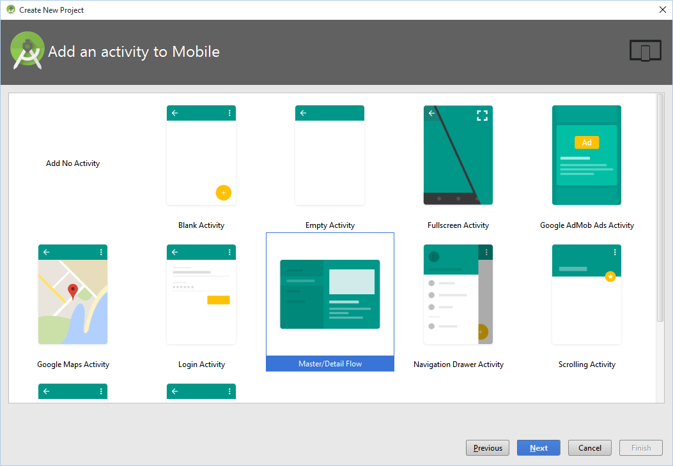
Adding a Master/Detail Flow

Slide 8
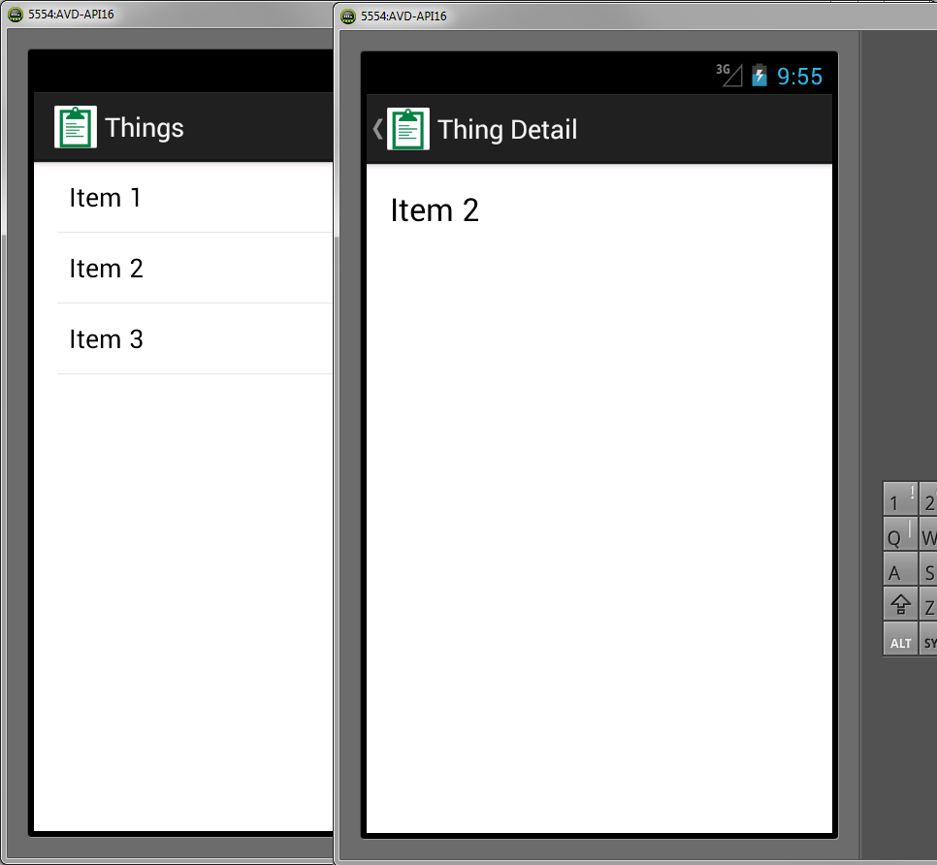
Smartphone Drill Down

